Slide 1


Internet of Things
Presentation to
Prof Ali Hayek
Presentation by:
Danish Zaheer Malik
2180556 ELE

Slide 2
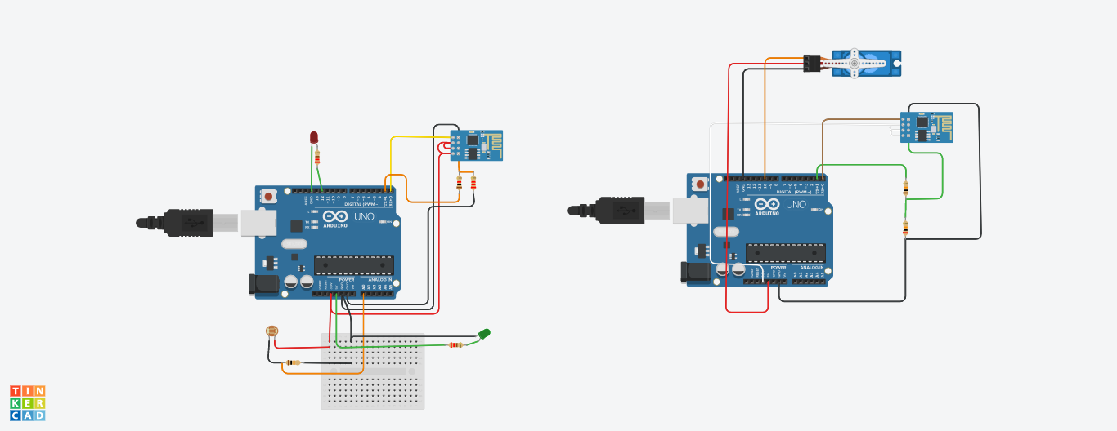
Photoresistor
LED
micro servo motor

Slide 3
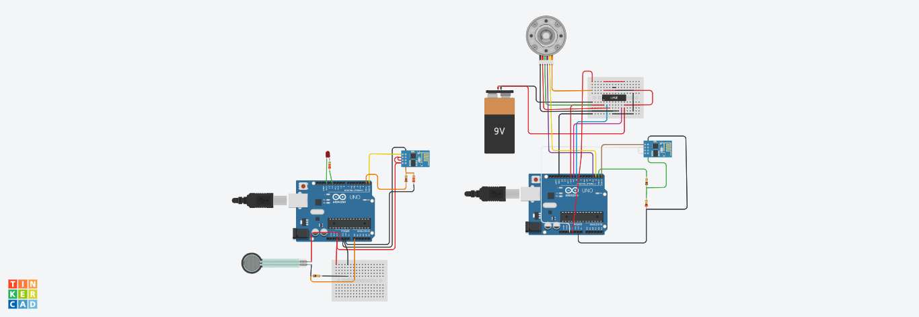
Force Sensor
Dc motor with encoder

Slide 4
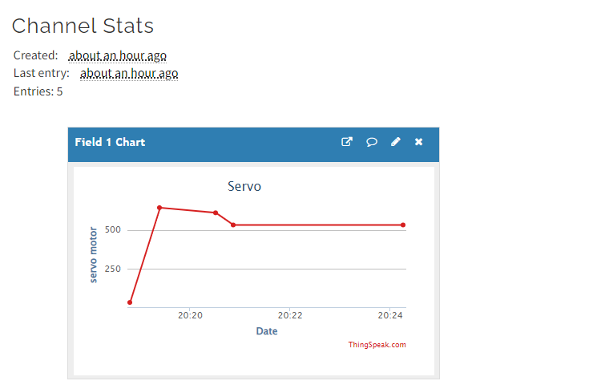

Slide 5
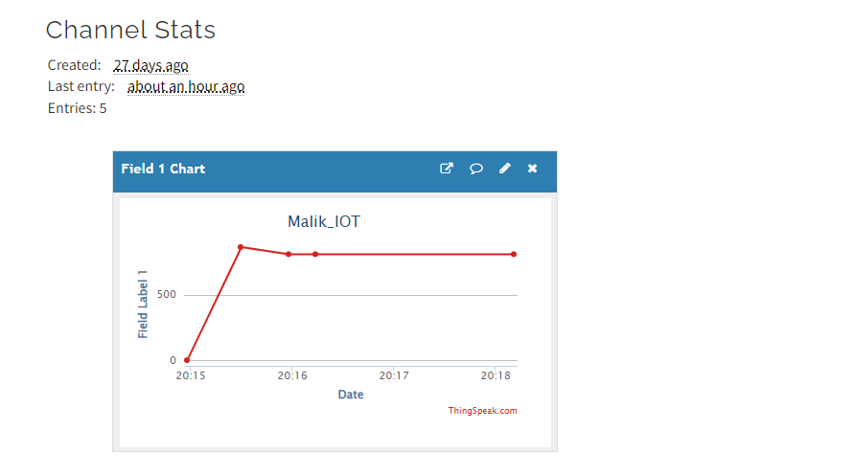

Slide 6
Tinkercad links
https://www.tinkercad.com/things/0a9w4Pd3nsU-thingspeaksendrecieve-project/editel?sharecode=_EDApYNxdjSLOfmBwgXOqX6iRsMBEjeP9YyIIcC1Q3c
https://www.tinkercad.com/things/9k1Htjhb5Et-thingspeaksendrecieveforcesendcenc-projectv2/editel?sharecode=CZzJXzzOX6RjiWe5zl_IQ9sVsbmgrOxQUbJMeU0l2uE

Slide 7
THE END

